Slide 1
Elevating your Python Stack: A practical approach to dependency upgrades
Mohammad Ahtasham - Software Engineer

Slide 2
Who am I?
Software Engineer @ Arbisoft/2U
Been using Python for almost 4 years now
Veteran of:
1 large Python upgrade project
2 large Django upgrade projects
1 large Node upgrade project.
And an occasional Gamer as well 🎮

Slide 3


Agenda
First look/recap into upgrade process
Manual upgrade process
Automating code refactoring
Automating CI/Config updates
Upgrading at Scale
Demos
Notes:
Download the repo(checkout to dev first on Github UI) and place it on desktop

Slide 4
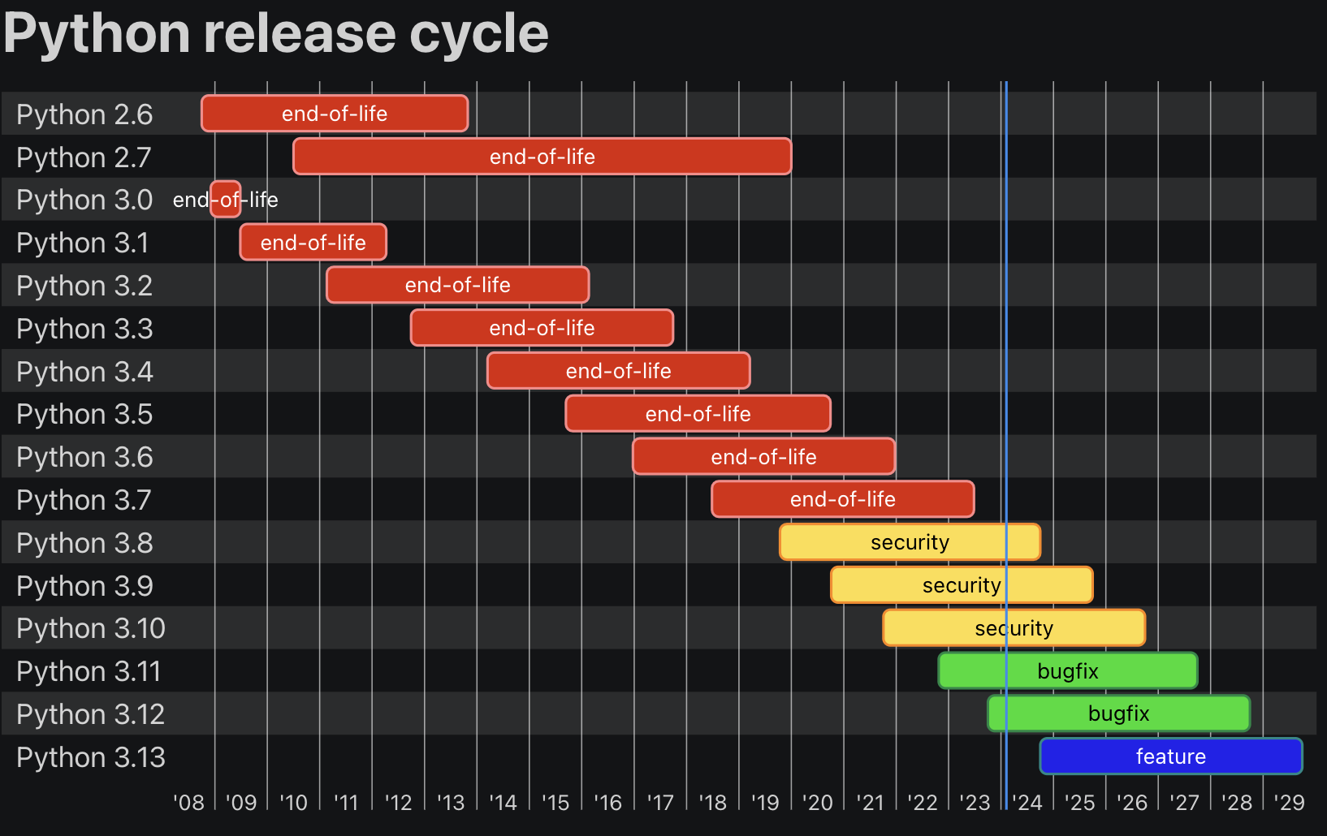
First look/Recap into Upgrade Process
EOL of a version is scheduled 5 years after first release
Planned releases with bug fixes in first 1.5 years and security releases afterwards.
Notes:
Python version benchmarks: https://docs.python.org/3/whatsnew/3.8.html#demos-and-tools
https://docs.openedx.org/projects/openedx-proposals/en/latest/archived/oep-0007-bp-migrate-to-python3.html
Why upgrade?
Is it worth it?
An example of Vulnerability: https://docs.djangoproject.com/en/4.2/releases/3.2.15/
Fix example: https://github.com/openedx/edx-platform/pull/30822

Slide 5
Manual Upgrade Process
Manual Upgrade Checklist:
Have Automated tests
Read the Release notes
Update your code according to new release
Upgrade your Python Dependencies
Fix any deprecation warnings(Optional)
Start testing with new Python version
Fix any breaking tests
Notes:
https://docs.python.org/3/whatsnew/3.8.html
https://stackoverflow.com/questions/576169/understanding-python-super-with-init-methods
Example of ABCs from Python 3.8 and code
What is Pip-tools and example of Requirements upgrade file and one file example https://github.com/jazzband/pip-tools
https://pypi.org/project/event-tracking/0.3.0/
https://pypi.org/project/event-tracking/1.0.0/
Depr warnings: https://github.com/aht007/edx-search/actions/runs/8179246446/job/22364908381?pr=1#step:7:9
Show example of tests failing on python 3.8 and passing on python 3.6

Slide 6
Automating Code Refactoring
What is a Codemod?
Black, isort etc. are also examples of codemods.
Frameworks for writing codemods: bowler, LibCST, pasta etc.
Various Codemods used @OpenedX can be found at:
https://github.com/openedx/repo-tools/tree/master/edx_repo_tools/codemods
Notes:
https://github.com/facebookarchive/codemod
https://github.com/browniebroke/django-codemod
https://github.com/adamchainz/django-upgrade
https://github.com/asottile/pyupgrade

Slide 7
When to Automate
Need to make change at dozens of places.
Changes don’t require any additional code context or judgment call.
The effort to Automate isn’t high.

Slide 8
Automating CI/Config updates
This part is not hard, but easy to forget.
Repetitive
This includes Yaml files, .ini files, setup.py etc
Various Codemods used for this purpose can be found @:
https://github.com/openedx/repo-tools/tree/master/edx_repo_tools/codemods/django3
Notes:
https://medium.com/@ahthassan74/tox-in-action-testing-your-code-across-multiple-version-releases-d4eaef1344ed
https://github.com/openedx/repo-tools/blob/master/edx_repo_tools/codemods/django3/tox_modernizer.py
https://github.com/openedx/repo-tools/blob/master/edx_repo_tools/codemods/django3/github_actions_modernizer.py

Slide 9
Upgrading at Scale
Pip-tools(pip-sync, pip-compile)
A Combination of:
Pip-tools,
Requirement files,
Make file
PyGithub and Github Actions
Upgrade Requirements workflow
Bulk Repo Update Workflow
Notes:
https://github.com/jazzband/pip-tools
https://github.com/openedx/.github/blob/master/.github/workflows/upgrade-python-requirements.yml
https://github.com/edx/.github/blob/master/.github/workflows/bulk_repo_update.yml
https://github.com/openedx/testeng-ci/blob/master/jenkins/pull_request_creator.py

Slide 10
Demos from edX/2U
Requirements file structure
Python Requirements Upgrade workflow
Bulk Repo Upgrade Job
Notes:
https://github.com/openedx/course-discovery/tree/master/requirements
https://github.com/openedx/course-discovery/blob/master/.github/workflows/requirements-upgrade.yml
https://github.com/aht007/edx-search/commit/2f58d76fc111a2912e7ee1eb97fd90b3aa7f38d0
https://github.com/openedx/testeng-ci
https://github.com/edx/.github/blob/master/.github/workflows/bulk_repo_update.yml
https://docs.openedx.org/projects/openedx-proposals/en/latest/best-practices/oep-0018-bp-python-dependencies.html

Slide 11
That’s it!!!
Need Help?
You can always contact me: @: ahthassan74@gmail.com
IN: linkedin.com/in/mohammad-ahtasham

